Slide 1
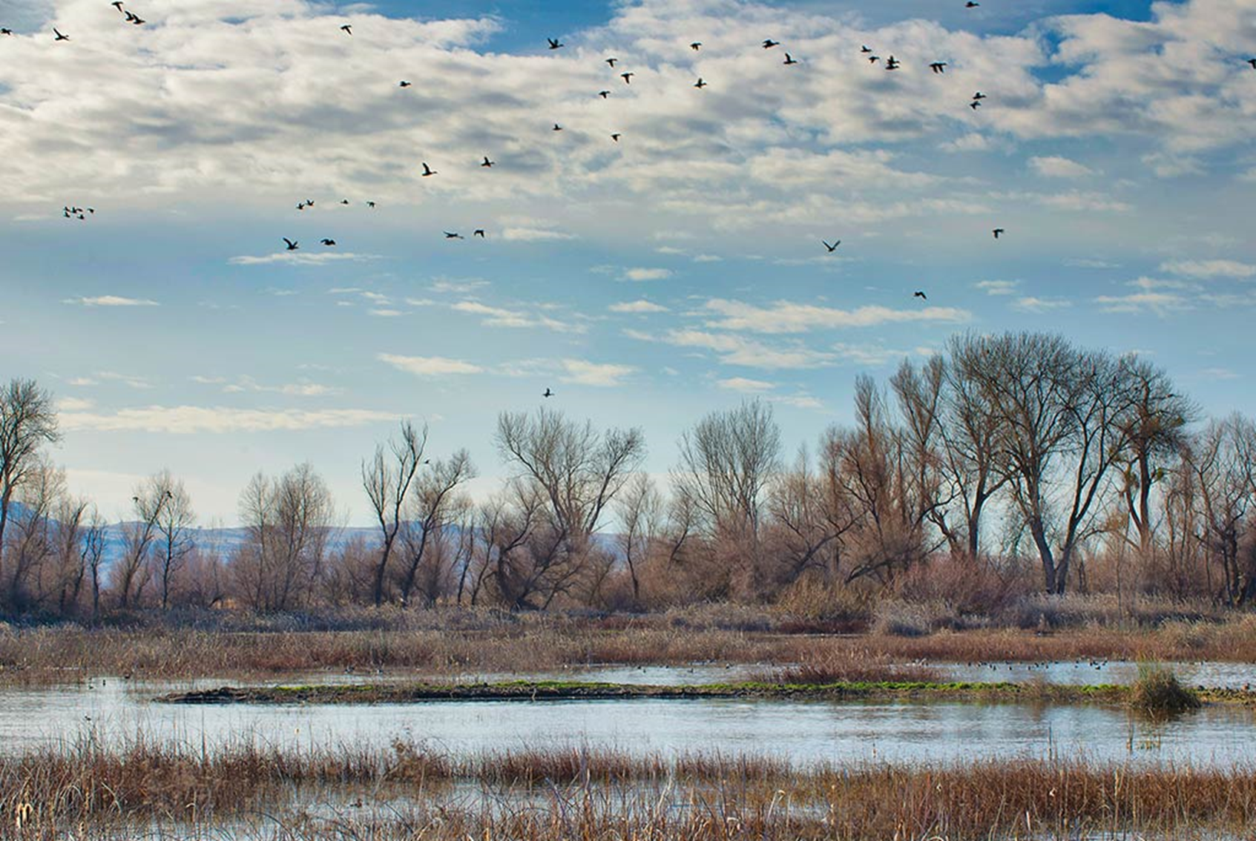

Managing Floodplains for Multiple Benefits
October 2018
Upper Mississippi River Conference
Moline, IL
Eileen Shader
Director, River Restoration
eshader@americanrivers.org
Notes:
Introduce self

Slide 2
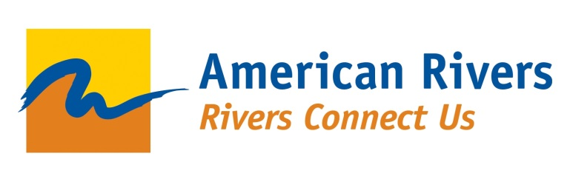
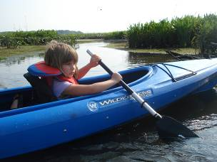
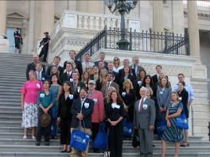
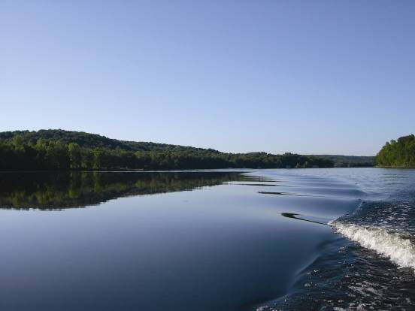

Founded in 1973, American Rivers protects wild rivers, restores damaged rivers, and conserves clean water for people and nature.
Headquartered in DC, American Rivers has offices across the country and more than 200,000 supporters, members, and volunteers nationwide
Notes:
Introduce American Rivers
We protect wild rivers, restore damaged rivers and conserve clean water for people and nature.
headquartered in DC, staff throughout the country in 11 priority river basins.
In UMRB we have Olivia and Brad
I work with them and rest of team to facilitate floodplain restoration and reconnection projects through policy change, capacity building, and project implementation.

Slide 3
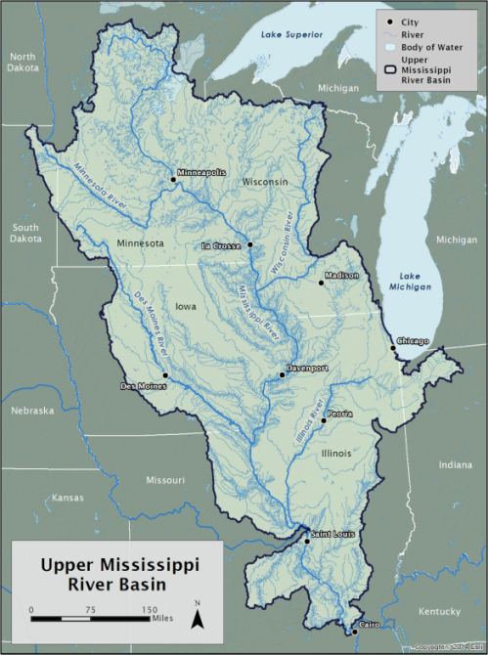

Overview
Presentation Overview:
Natural functions and benefits of floodplains
Strategies for maximizing floodplain benefits
Trends and Tools in support of floodplain restoration
Notes:
Focus on managing floodplains for multiple benefits
First, quick overview of natural functions and benefits of floodplains
Quick overview of strategies, particularly state and basin level approaches
Then new trends and tools to help communities implement floodplain restoration projects
We heard XXX use the famous quote “Floods are acts of god, flood damage is an act of man”
We are going to hear a lot about mitigating flood risk in this track over the next two days so it’s important to remember:

Slide 4
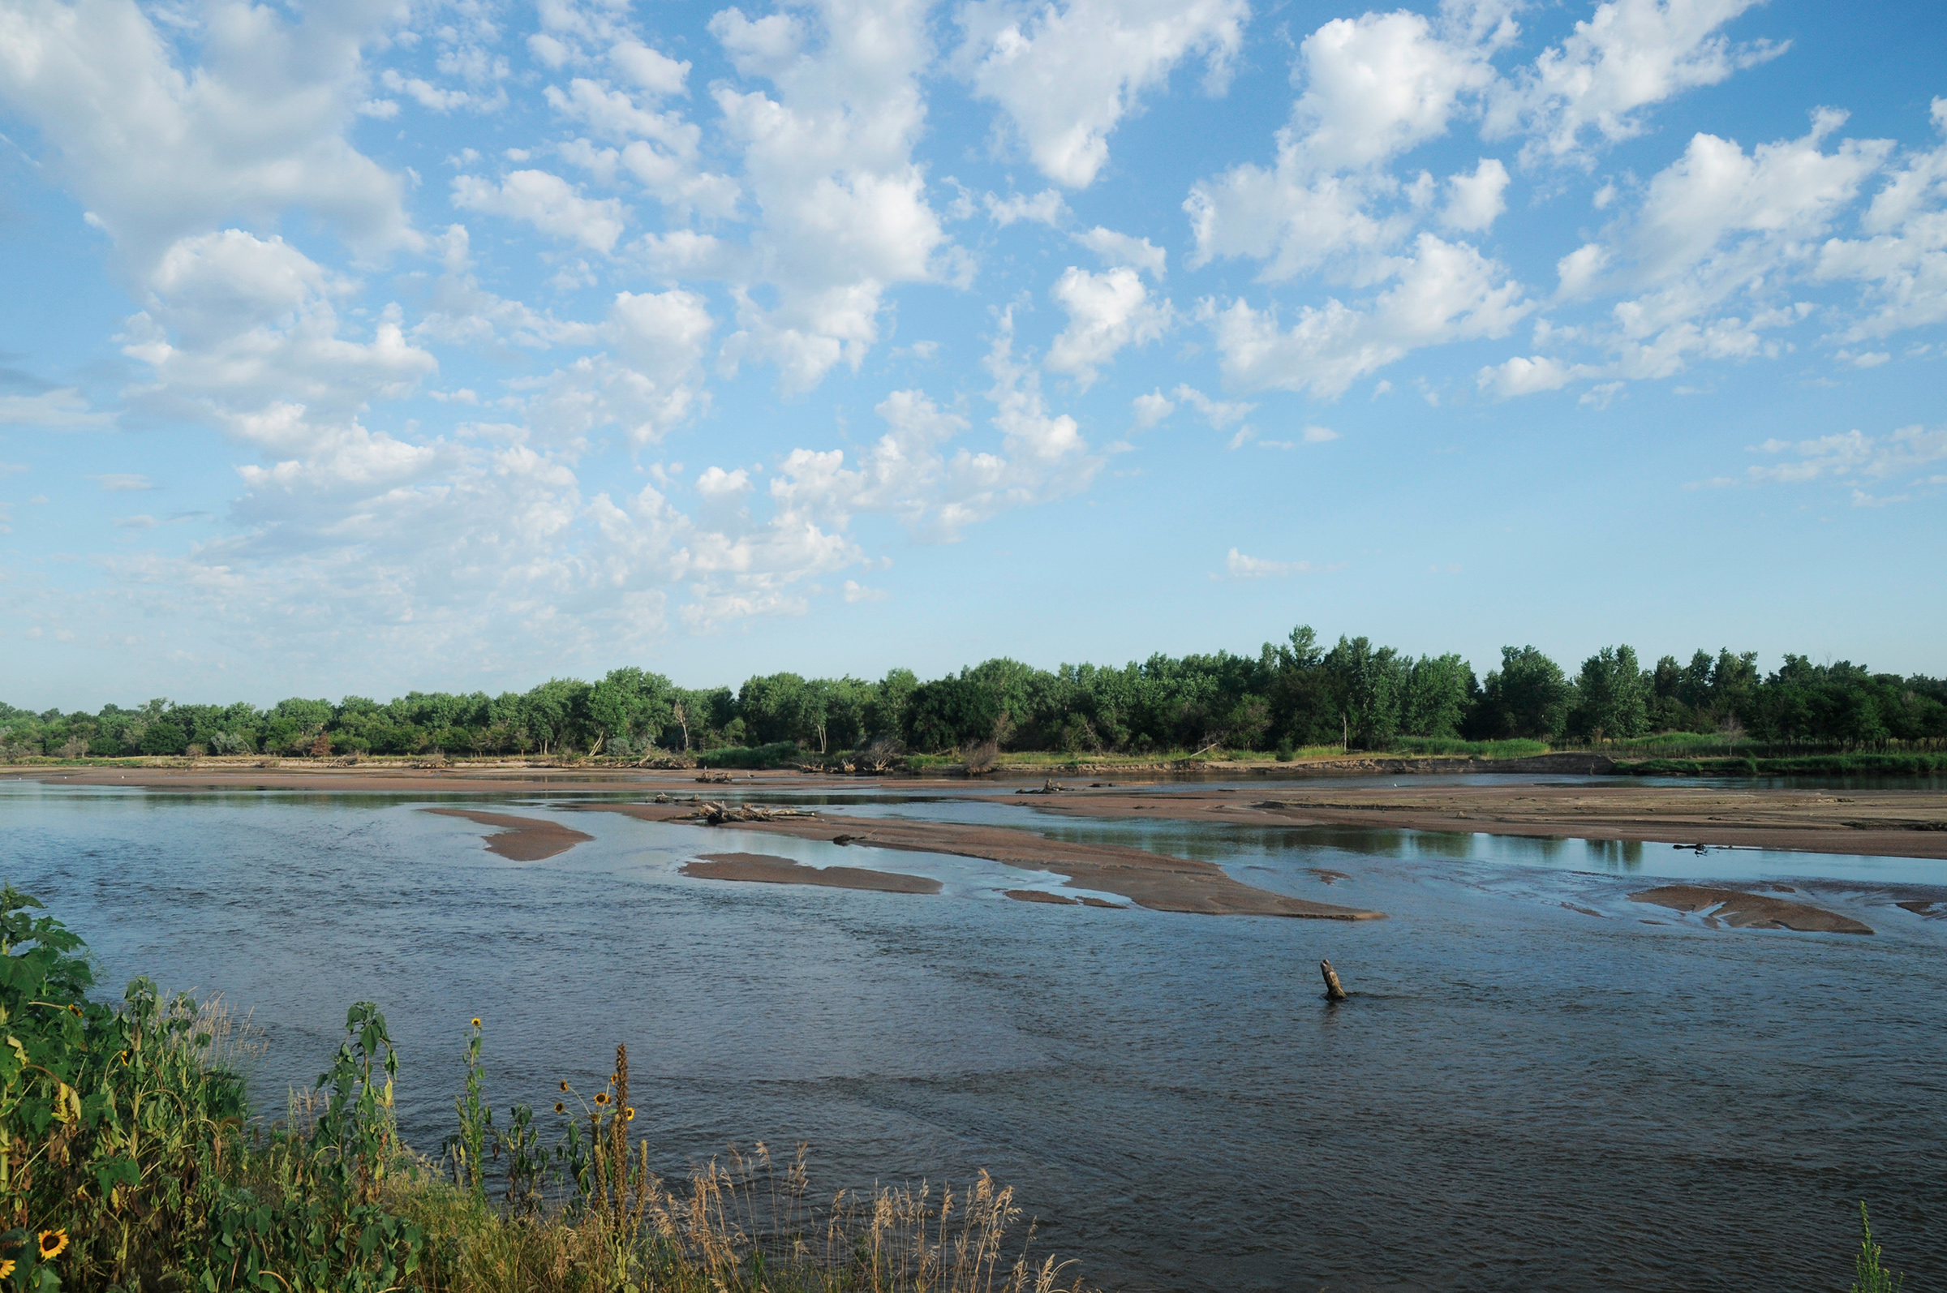
Rivers Flood
Floods drive natural processes and ecosystem functions that sustain rivers and create floodplains.
Notes:
That floods are natural! Floods are good. Floods are necessary.
Floods are a critical process in the life cycle of a river
Water flowing over land drives the chemical, biological and physical processes that make floodplains beneficial to communities.
During floods:
Fish and animals get access to spawning habitat and food sources
microbes in the soil explode in population and suck nutrients out of the water column which improves water quality
sediment is eroded and transported as the river find equilibrium
Even big floods are important for changing the landscape.
http://plattebasintimelapse.com/wp-content/uploads/2015/08/near-plum-creek-scoured-sandbars.jpg

Slide 5
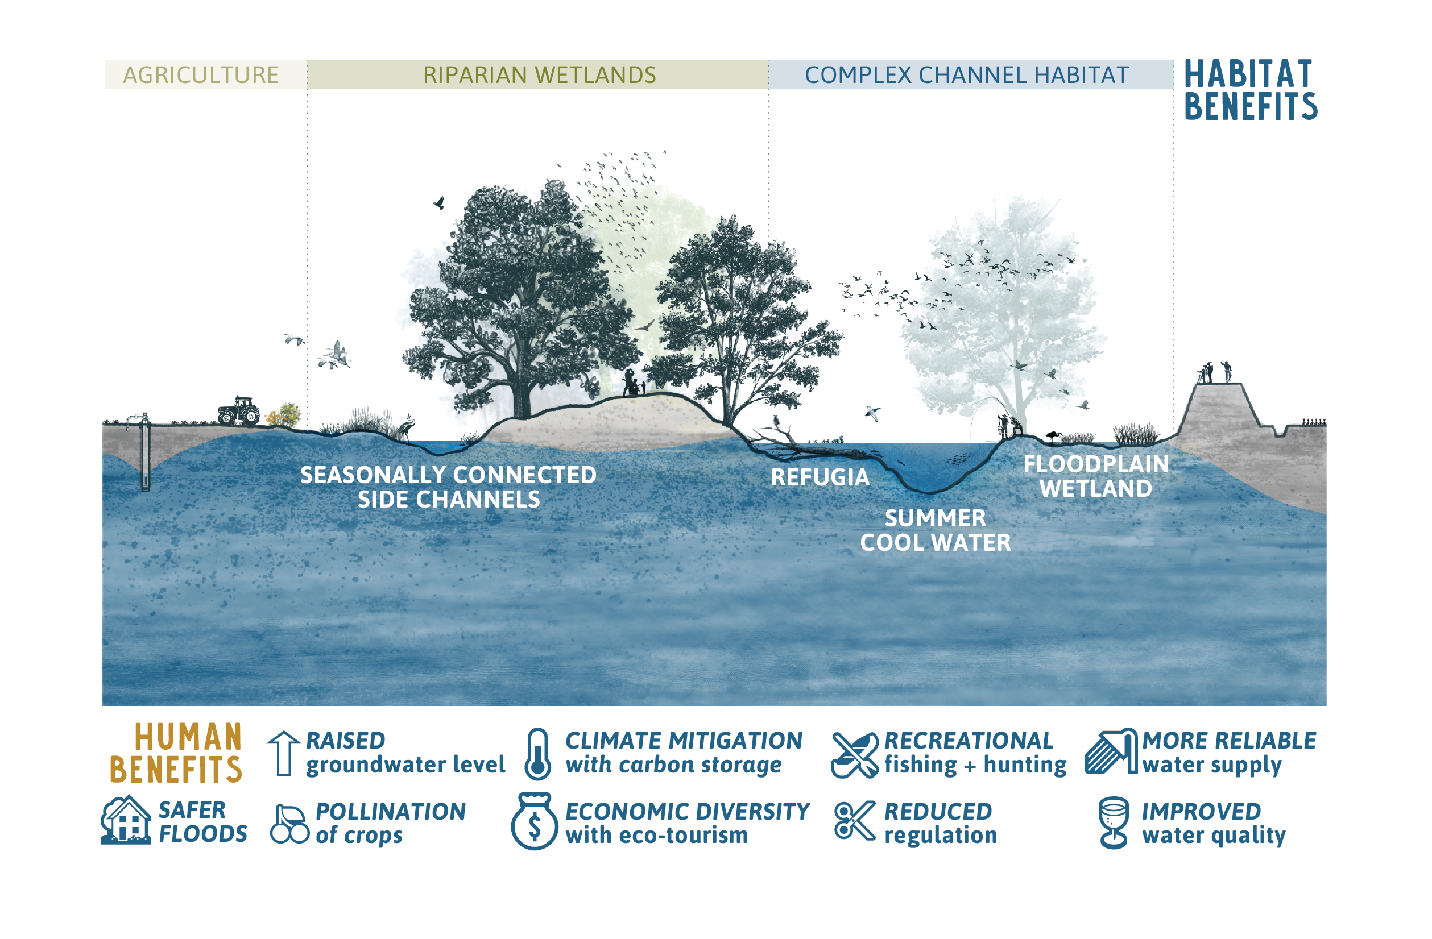
Benefits of a Connected Floodplain
Notes:
It’s because of floods that floodplains bring a wealth of benefits, not just to the fish and birds and bunnies.
Also to people- improved water quality, groundwater, climate mitigation, etc.
But instead of this on many of our rivers we have…

Slide 6
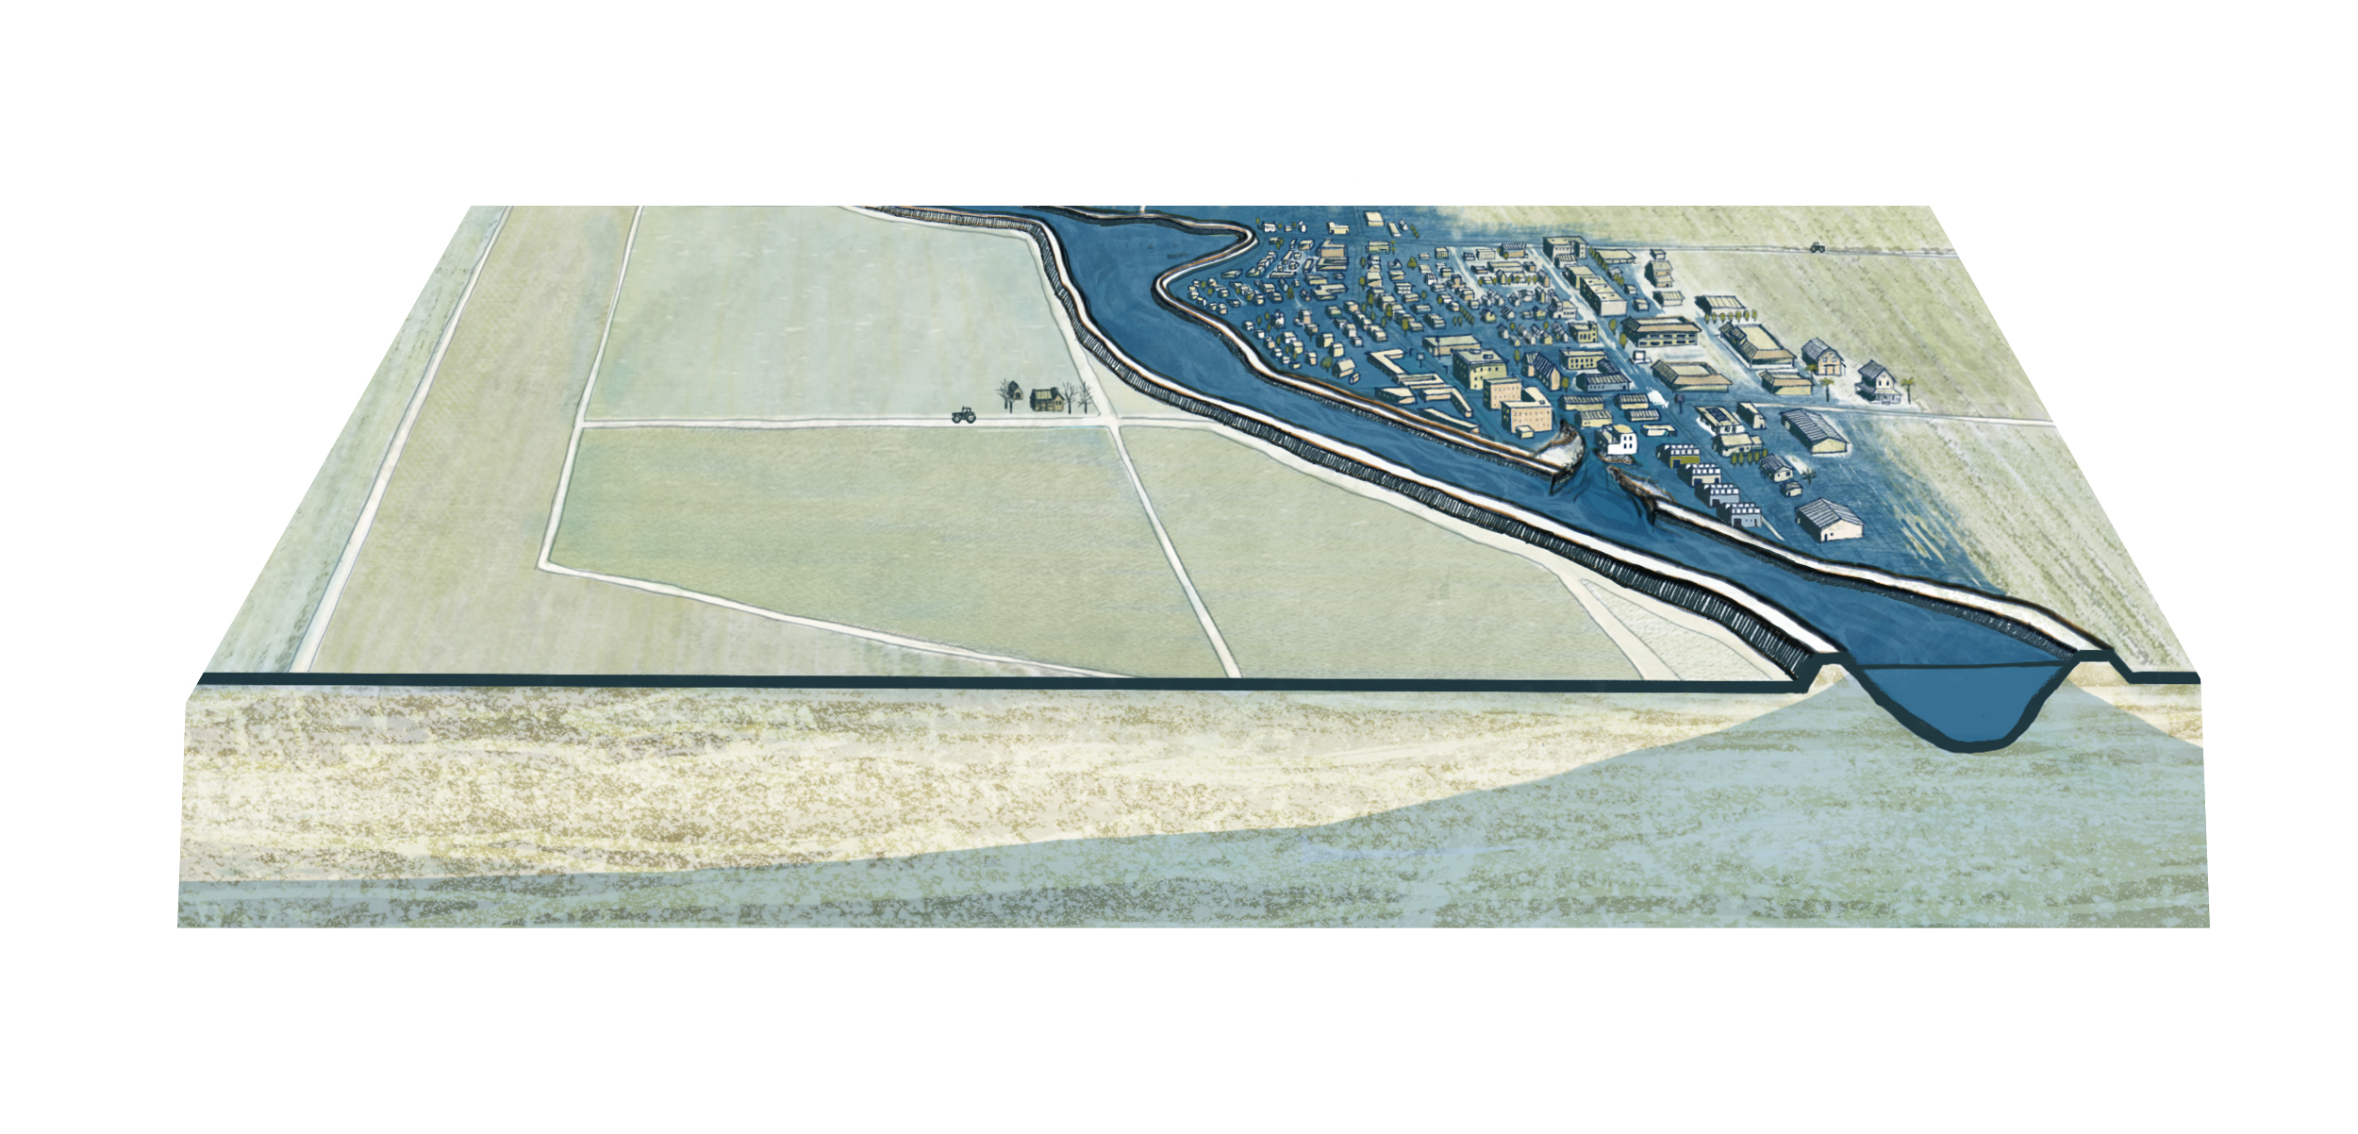
Notes:
This.
Rivers disconnected from floodplains
Land converted to one use- generally agricultural or urban
Water moving off the landscape and downstream as quickly as possible
With the inevitable consequences to public safety.

Slide 7
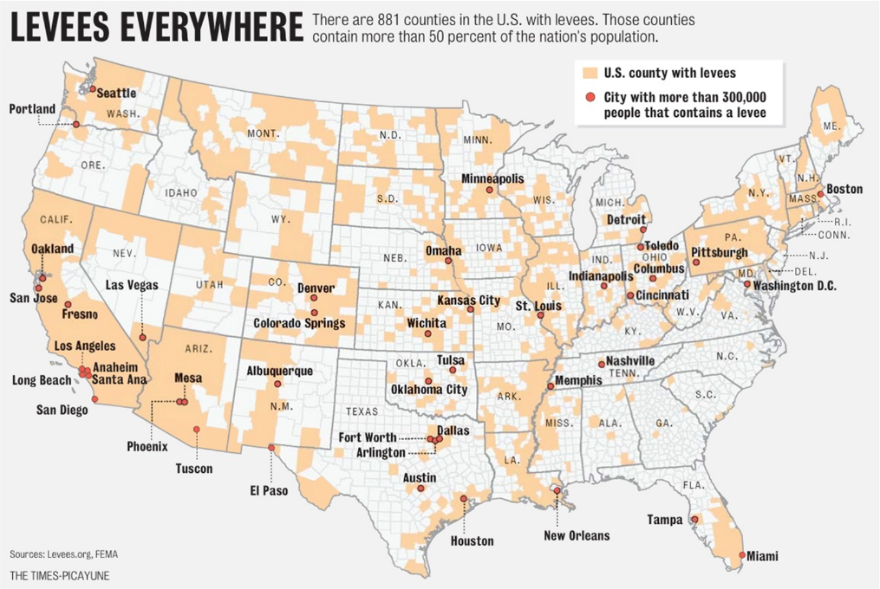
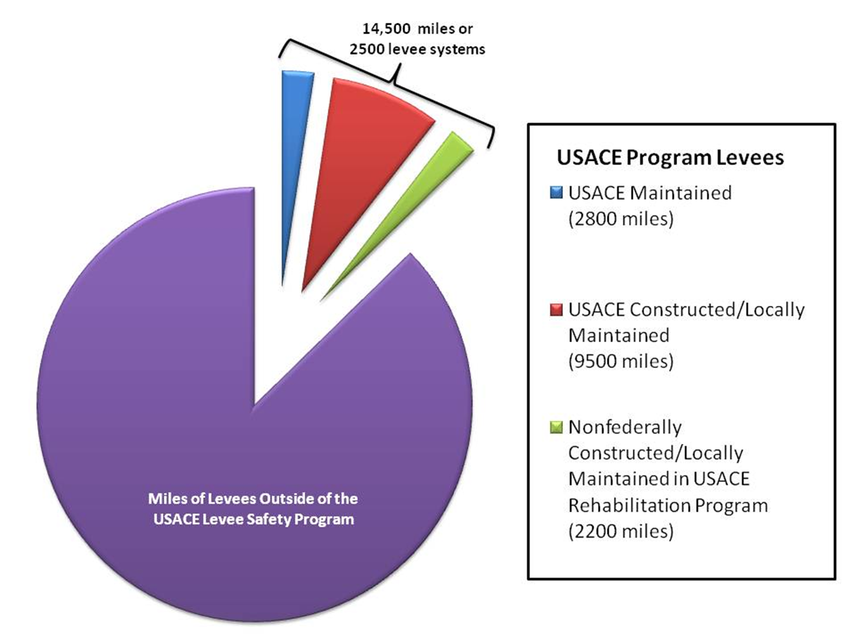
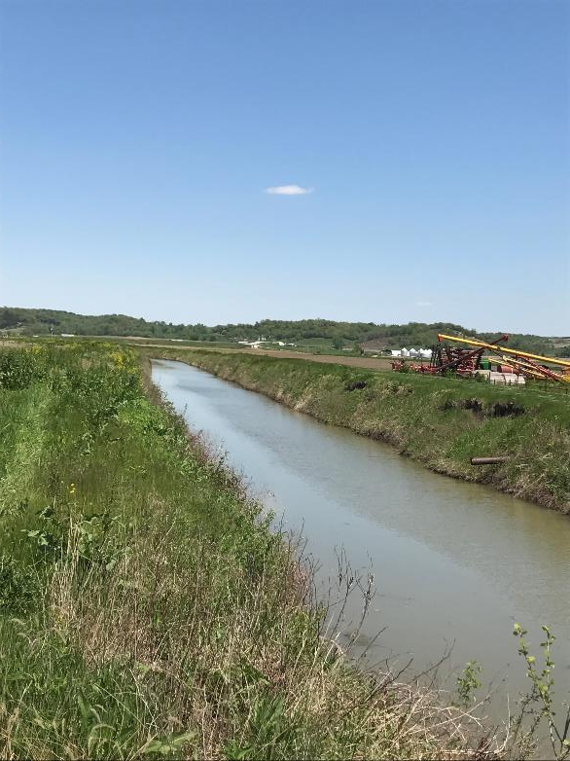
Extent of floodplain disconnection
What we know:
Nationally, the USACE has almost 15,000 miles of USACE levees in their National Levee Safety Database. That represents 10 percent of levees in the U.S.
  ~8000 miles in the Upper Mississippi basin
“To this day the amount, location and condition of agricultural levees across the UMRB are poorly documented, although there are nearly 5,000 known drainage districts in Illinois, Iowa, and Wisconsin.”
“Nearly 25% of surface water resources in the state [of Illinois] have been modified directly by channelization and/or levee construction”
“
Notes:
A few years ago, AR performed a conservation assessment for the Upper Mississippi River Basin that identified floodplain disconnection as one of the most underserved issues in the region.
It’s pretty hard to get total numbers of the extent of floodplain restoration but here’s what we know:
- No one, including the Army Corps, knows where all the levees are.
The 15,000 or so miles of USACE levees in the National Levee database represent only 10 percent of levees across the US.
- Most levees were built back when the land was being settled. Farmers straightened stream channels and dumped excess dirt up on the stream banks.
There are about 5000 known drainage districts in IL, IA, and WI alone.
And it’s estimated that 25% of IL surface waters were modified directly by channelization or levee construction.
- So even if a river or stream doesn’t have two enormous
Sources:
1) Levees Everywhere image: The Times-Picayune, sourced from Levees.org, FEMA. 2010 http://levees.org/2010/01/03/the-new-orleans-region-and-its-levees-is-not-alone/
http://blog.nola.com/levees/2010/01/what_is_leveesorg.html
2) USACE Levee miles: USACE Levee Safety Program https://www.usace.army.mil/Missions/Civil-Works/Levee-Safety-Program/USACE-Program-Levees/
3) Implementing Nonstructural Solutions for Flood Management in the Upper Mississippi River Basin, Montgomery and Associates, prepared for American Rivers
4) Channelization and levee construction in Illinois: Review and implications for management. Mattingly, Rosanna, Edwin Herricks, and Douglas Johnston. Environmental Management. Nov 1993, Vol 17, Issue 6, p 781-795. https://link.springer.com/article/10.1007/BF02393899

Slide 8

Strategies for Maximizing Floodplain Benefits
Notes:
So let’s talk about some of the strategies for restoring floodplains in a way that maximizes their benefits.

Slide 9
A note on terminology…
They all include restoration of floodplain functions and benefits
Room for the River
Nature-based Approaches
Multi-benefit projects
Climate Resilience Projects
Natural Infrastructure
River Corridor Protection and Restoration
Floodplain Restoration
Floodplains by Design
Nature-Based Solutions
Notes:
First- a note on terminology
There are so many buzz words out there right now for water management strategies that mimic or restore natural conditions of rivers or the landscape.
I’m going to use several of these later on b/c they’re in law or a program name.
Just know that when we’re talking about floodplains, to me the important question is whether the action you’re talking about will restore floodplain functions and benefits to communities.

Slide 10

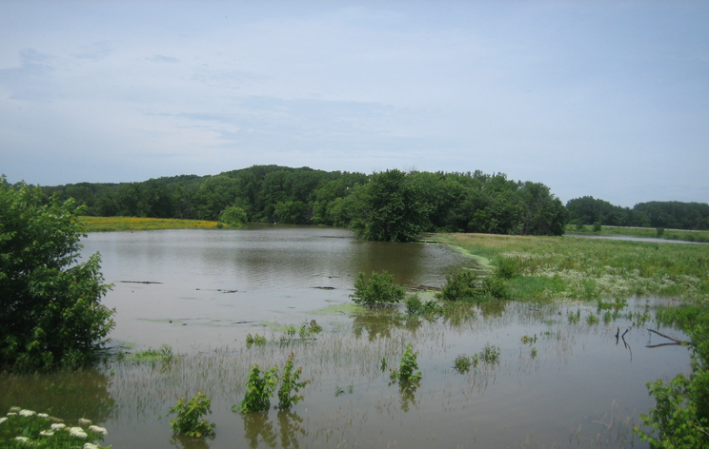
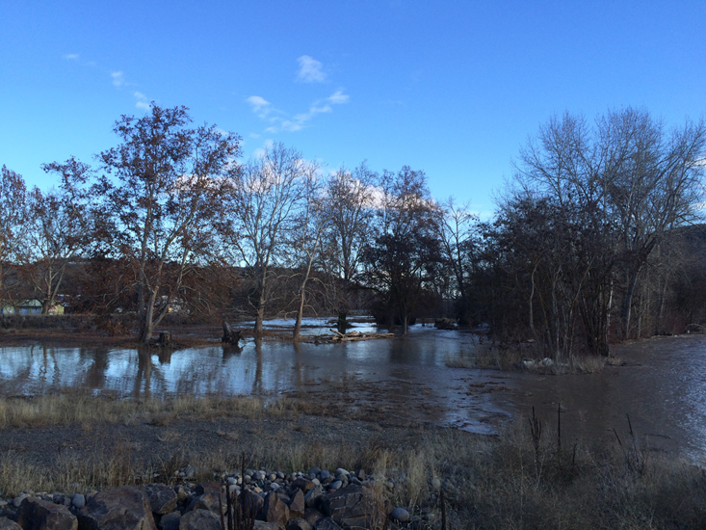
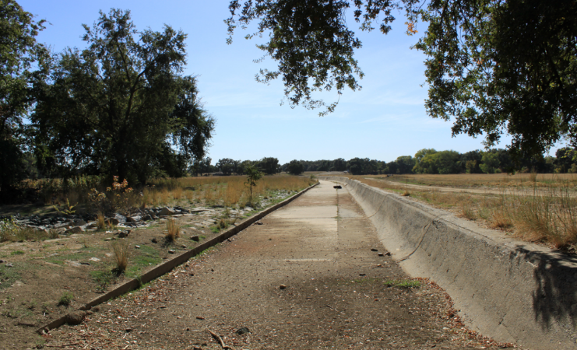
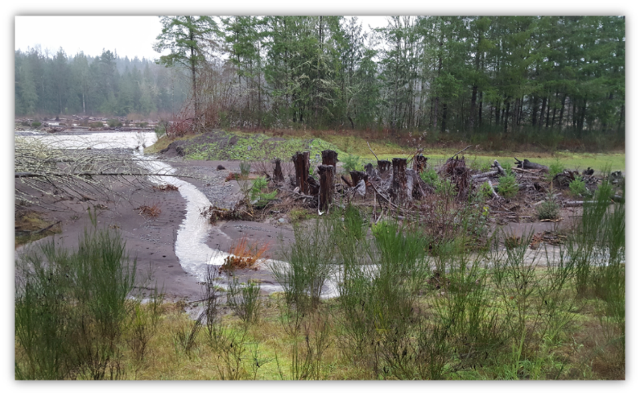
Restoring Functional Floodplains
Connectivity
Variable Flow
Habitat and Structural Diversity
Spatial Scale
Floodplain Restoration Projects
How are floodplains restored?
Notes:
So how do you restore floodplains to maximize their functions and benefits?
From a river process perspective, you have to address these four attributes:
Connectivity- the water needs to be able to get onto the floodplain
Variable Flow- flows should be variable in timing, depth, and duration- important for species
Spacial Scale- big enough to have benefits
Habitat and Structural Diversity- appropriate diversity on the landscape, side channels, wetlands, vegetation, etc.

Slide 11
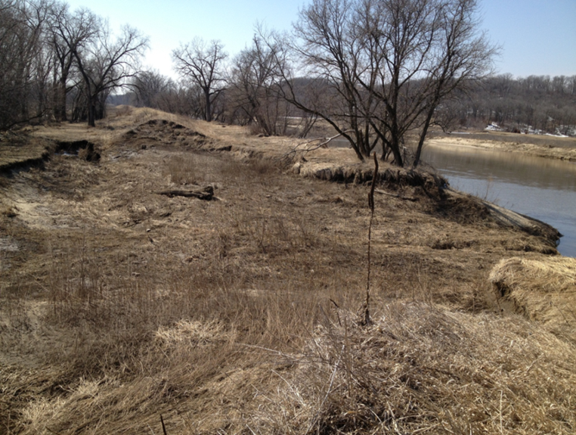
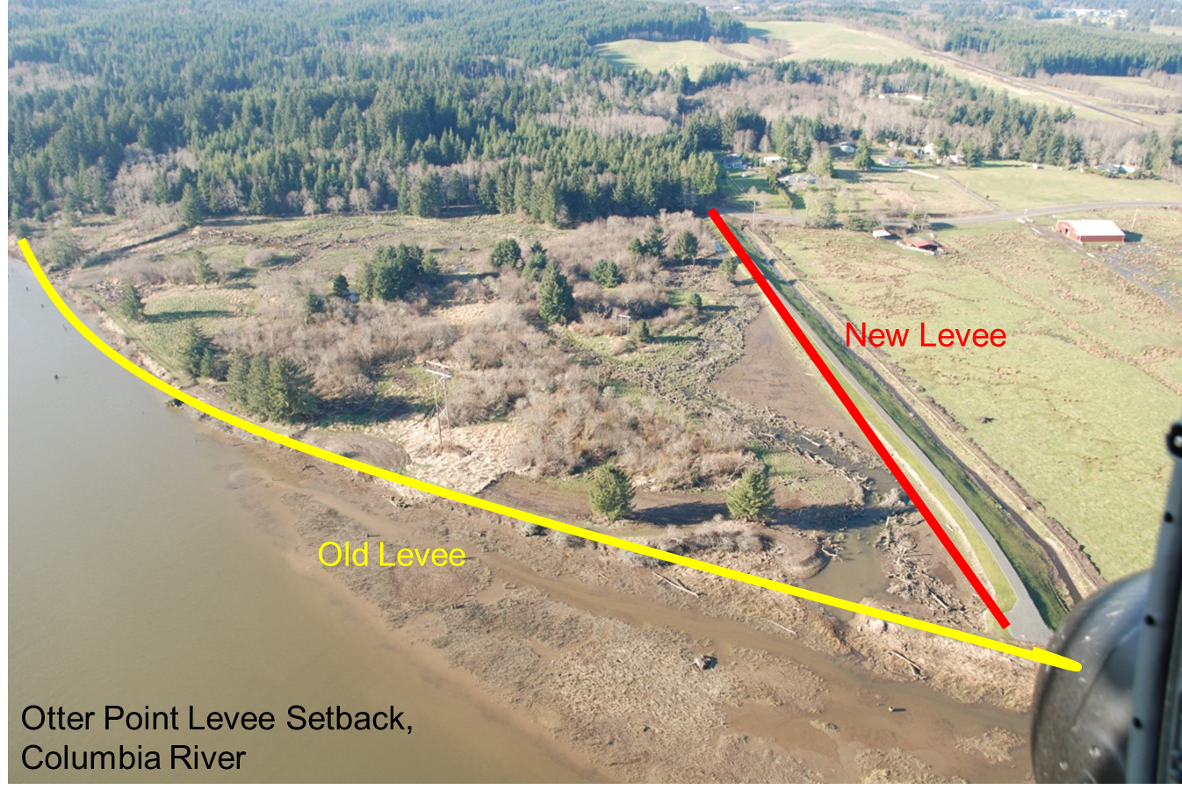
Floodplain reconnection and restoration techniques
Alter levees- setback, breach, remove
Install floodplain terrace
Flood bypass
Address causes of flow alteration
Restore floodplain activating flows
Address water withdrawals
Conservation easements
Land acquisition
Land transfer
Passive restoration
Enhance woody debris
Riparian planting
Manage non-native species
Restore habitat diversity
https://www.americanrivers.org/conservation-resource/reconnecting-floodplains/
Notes:
- Every project is unique and the specific actions that go into it are varied according to the needs and the specific benefits that you’re trying to achieve.
If we’re dealing with leveed floodplains, a key component would be to alter by removing it, breaching, setback, or if necessary a water control structure in order to allow water to get back onto the floodplain.
The photos show two examples of levee alterations- first is a levee in iowa that breached during a flood. The land behind was acquired and the levee left unrepaired to naturally erode over time.- Maquoketa
The second is a levee setback, where the old levee close to the river was removed and reconstructed further from the river.
- If a floodplain is already connected, but it’s been in agriculture for decades, it might require some earth moving and planting to restore diverse land features- side channels, wetlands, and so on.

Slide 12

Basin Level Strategies:
CA Central Valley Flood Plan
Primary goal:
  Improve flood risk management
Supporting goals:
  Improve operations and maintenance
  Promote ecosystem functions
  Improve institutional support
  Promote multi-benefit projects
Source: The Bay Institute, Sierra to the Sea. http://www.bay.org/publications/sierra-to-the-sea
Notes:
Let’s scale it up and talk about a couple of successful basin and state level strategies.
First, the Central Valley of California.
Very different ecosystem from the Midwest- but also a region where they’ve lost significant historical wetlands due to landscape changes and conversion to agriculture- <5% left
Huge flood threats with 1 million people and $70Billion in development protected by aging, structural system.
A huge demand for restoration due to impacts to endangered species.
Very long story short- in 2018 they adopted a regional flood plan focused on “multi-benefit projects” like flood bypasses, floodplain reconnection that will give rivers more room to spread out during floods, while restoring critical habitat for endangered species.
The image is Fremont Weir on the Yolo Bypass- it’s going to be notched to allow water to access the floodplain every year or two

Slide 13
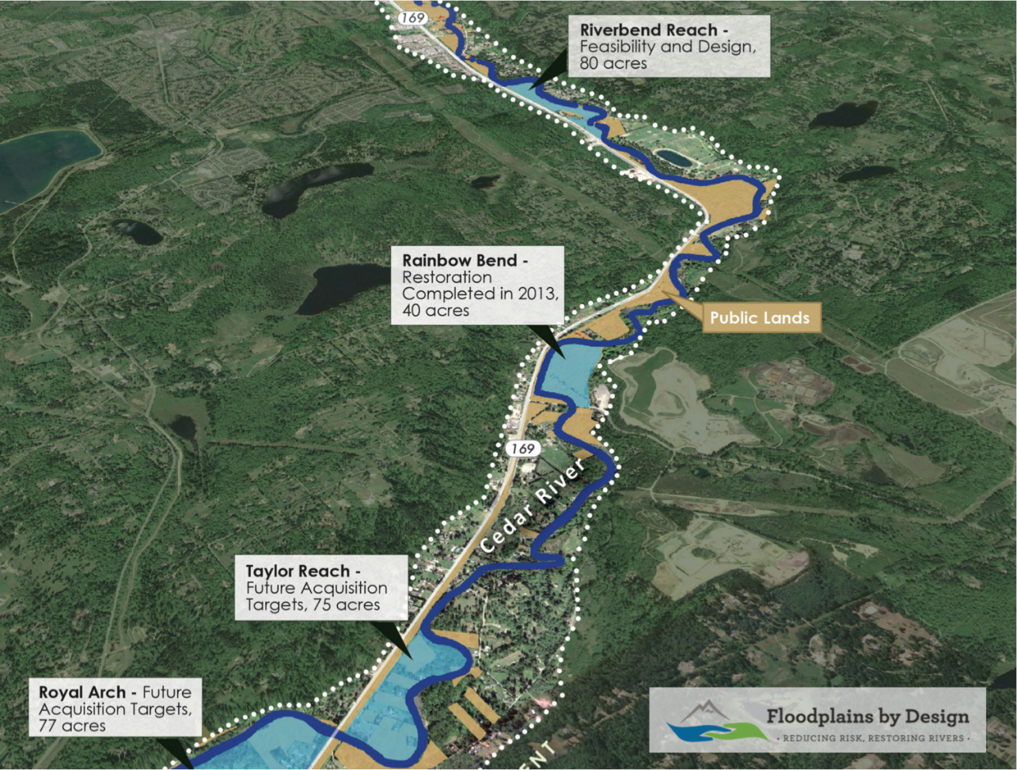
State Level Strategies: Washington State Floodplains By Design
Notes:
Another state that’s adopted the Multi-benefit approach is Washington
They have a state grant program called Floodplains By Design
Local communities can apply for funding, but projects have to achieve multiple benefits- flood risk reduction and habitat restoration.
You can’t skimp and just plant some trees, you need real habitat restoration.

Slide 14
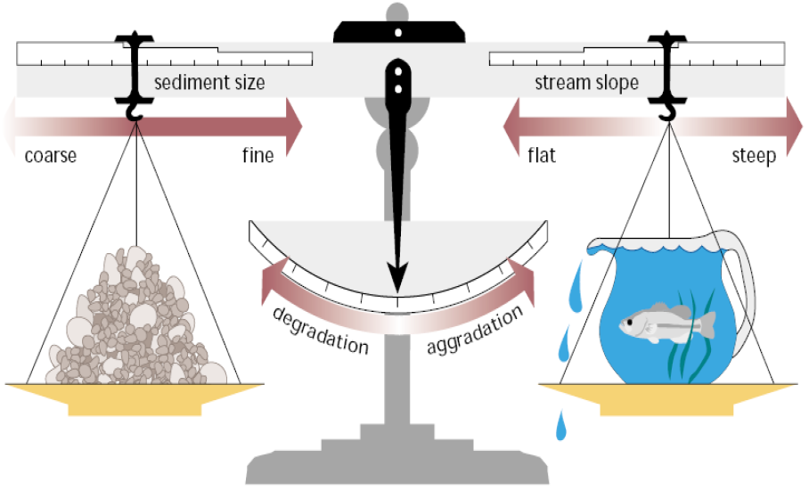
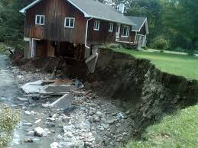
State Level Strategies:
Vermont River Corridor Protection and Restoration
Notes:
Finally, a different approach in Vermont, which is the gold star in terms of state agency river management in my book.
Their Rivers Program goes beyond just planning for multiple benefits and manages their rivers based on river function.
River stability- whether they are meandering, eroding or depositing sediment, etc- depends on the balance between sediment, water quantity, energy, slope.
They realized that after centuries of channelizing streams, their rivers were severely incised and eroding their banks, putting many houses that were technically out of the floodplain, at risk of literally falling into their streams and rivers.
So they started mapping river corridors- where the river wants to go.
And focused floodplain protection and restoration within the corridor, because that would allow the river space to move within the channel and find equilibrium and create functional floodplains.

Slide 15
Trends and Tools in support of Floodplain Restoration
Notes:
Let’s scale up a little higher and look at some of the national level policy trends and new tools for FPR

Slide 16
Trends: New USACE Requirements
America’s Water Infrastructure Act of 2018 (aka WRDA)
SEC. 1149. INCLUSION OF ALTERNATIVE MEASURES FOR AQUATIC ECOSYSTEM
RESTORATION.
(b) Amendment to Definition.--Section 1184(a)(2) of the Water Resources Development Act of 2016 (33 U.S.C. 2289a(a)(2)) is amended by striking ``in coastal areas''.
(c) Natural Infrastructure.--In carrying out a feasibility report developed under section 905 of the Water Resources Development Act of 1986 (33 U.S.C. 2282) for a project for flood risk management or hurricane and storm damage risk reduction, the Secretary shall consider the use of both traditional and natural infrastructure alternatives, alone or in conjunction with each other, if those alternatives are practicable.
Notes:
Congress just passed a WRDA bill.
Bill that makes policy change for the Army corps and authorizes projects
We were thrilled to see this provision in the bill.
Strong language requiring the Corps to consider natural infrastructure alternatives for every flood risk management feasibility study.
There was similar language in 2016 bill, but wasn’t as strong and it specified “coastal areas”.

Slide 17
Trends: USACE NNBF Guide
Notes:
The Corps, to their credit, is already making progress on this front.
One example- they’re working on a big project to create international guidelines for natural and nature-based features for flood risk management.
The Corps has really increased the focus on nnbf since Hurricane Sandy- especially on the coasts.
Happy rivers are being addressed
Looking forward to these policy changes and guidelines trickling down to project level

Slide 18
Trends: Natural Infrastructure in Hazard Mitigation Planning
Notes:
There are also trends in the right direction when it comes to incorporating floodplain benefits into hazard mitigation plans.
For anyone not familiar- FEMA requires states to develop hazard mitigation plans to be eligible for mitigation money after disasters are declared.
The EPA is starting to help communities integrate green stormwater infrastructure into hazard mitigation plans.
We’re interested in expanding that up to larger scale natural infrastructure and floodplain restoration.

Slide 19
Trends: Natural Infrastructure in Hazard Mitigation Planning
IL: Objective 2.6: Continuously demonstrate and capitalize upon the connection between hazard mitigation and sustainable development
Participate in state-level sustainable development initiatives
Coordinate with non-profits promoting sustainable development
Coordinate with organizations acquiring and connecting hazard-prone or environmentally sensitive lands
IA: Mitigation Objective: Build support capacity and commitment to prevent or reduce risks from all hazards for protection of Iowa’s residents and their property as well as the State’s natural resources
Develop and implement watershed studies and plans…support stormwater management
Establish natural vegetation buffers and removal of dead vegetation
MN: FLOODING GOAL: Reduce deaths, injuries, property loss, and economic disruption due to all types of flooding (riverine, flash, coastal, and dam/levee failure).
Natural Resource Protection: Stream corridor protection projects and restoration and soil erosion control projects will be used to prevent or reduce risks and increase the protection of natural resources from flooding.
Notes:
I think there’s a lot of room for growth on this topic. Most state plans have an action or two related to pursuing natural infrastructure, but it’s not very extensive.
I quickly scanned a few Midwest state plans- MN is by far the furthest along in terms of acceptance.

Slide 20
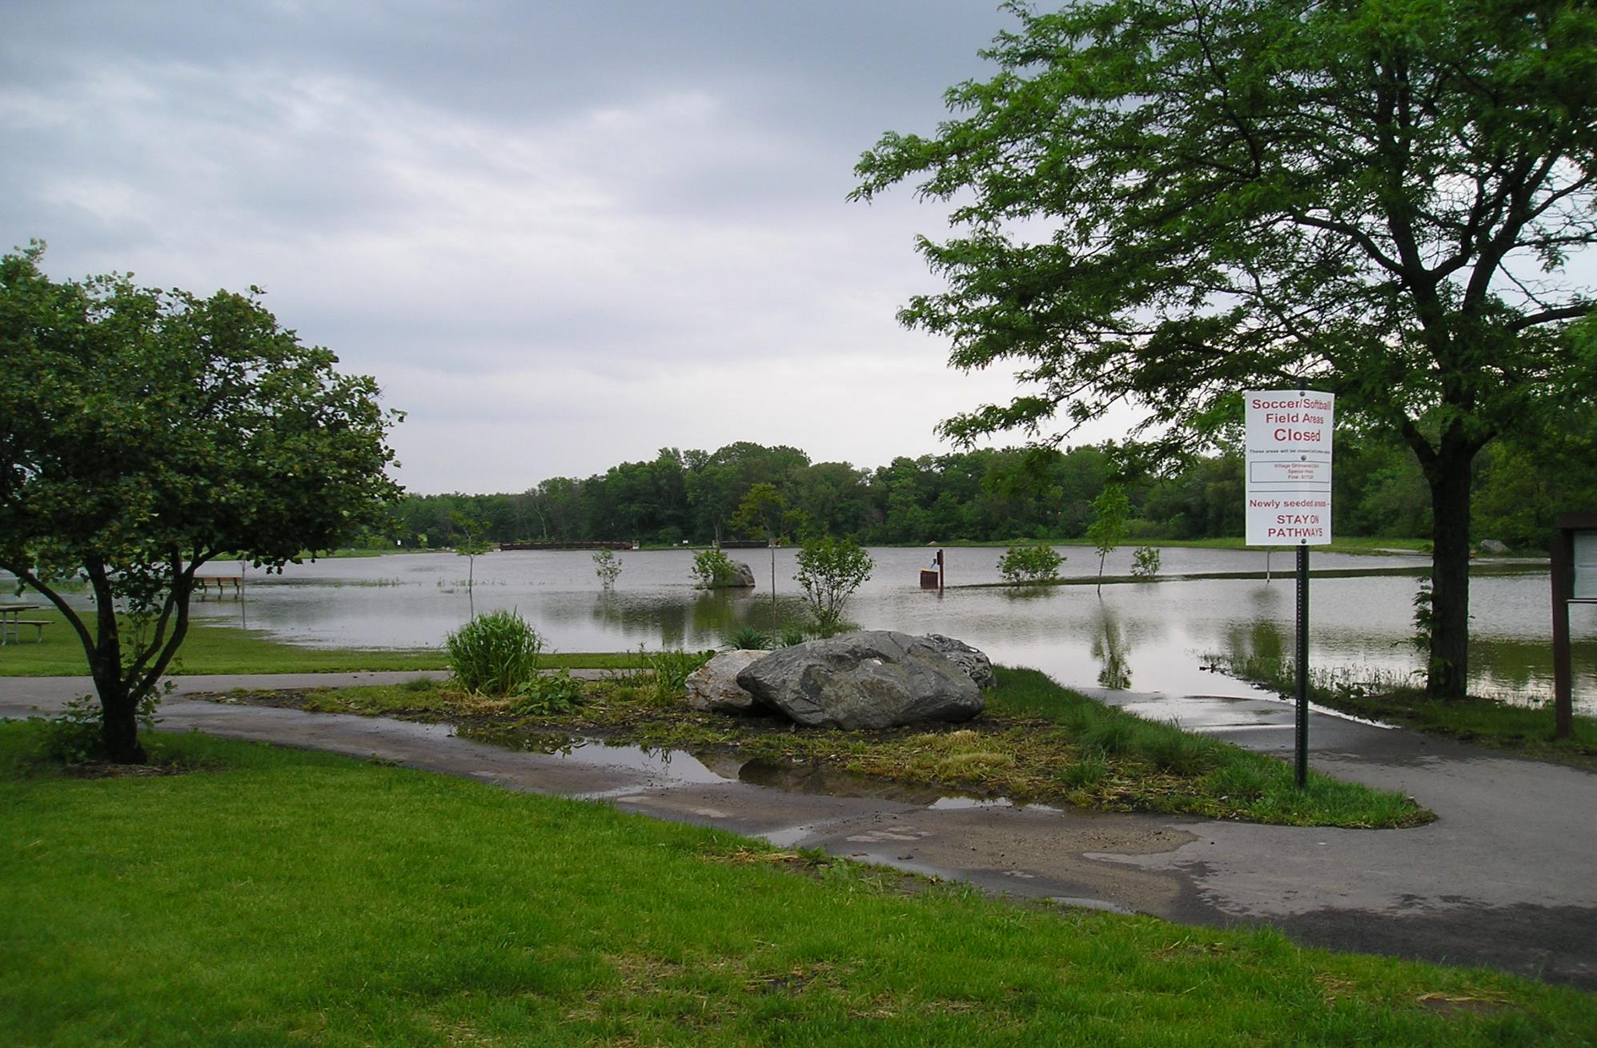
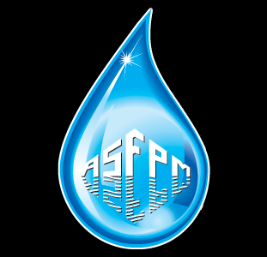
New Tools:
ASFPM Community Rating System
Green Guide
Element Name | Possible Points
322.g. Natural Floodplain Functions (MI7) | 20 points
332.a. Outreach Projects (OP) | 200 points
332.d. Stakeholder Delivery (STK) | 50 points
412.e. More Restrictive Floodway Standard (FWS) | 140 points
422.a. Open Space Preservation (OSP) | 1,450 points
422.b. Deed Restrictions (DR) | 50 points
422.c. Natural Functions Open Space (NFOS) | 350 points
422.d. Special Flood Related Hazards Open Space (SHOS) | 150 points
422.e. Coastal Erosion Open Space (CEOS) | 750 points
422.f. Open Space Incentives (OSI) | 250 points
422.g. Low Density Zoning (LZ) | 600 points
422.h. Natural Shoreline Protection (NSP) | 120 points
432.a. Development Limitations (DL) | 1,330 points
Element Name | Possible Points
432.l. Special Flood-Related Hazard Regulations (SHR) | 100 points
432.n. Coastal Erosion Hazard Regulations (CER) | 370 points
442.d. Erosion Data Maintenance (EDM) | 20 points
452.a. Stormwater Management Regulations (SMR) | 380 points
452.b. Watershed Master Plan (WMP) | 315 points
452.c. Erosion and Sediment Control Regulations (ESC) | 40 points
452.d. Water Quality Regulations (WQ) | 20 points
512.c. Natural Floodplain Functions Plan (NFP) | 100 points
Activity 520 522.a. Buildings Acquired or Relocated (bAR), 522.b. Buildings on the Repetitive Loss List (bRL), and 522.c. Severe Repetitive Loss Properties (bSRL) | 2,250 points
542.c. Capital Improvement Program (CIP) | 70 points
https://www.floodsciencecenter.org/products/crs-community-resilience/green-guide/
Notes:
I also want to mention a few new tools that folks might find useful for planning floodplain restoration projects and maximizing the benefits your community receives.
First is ASFPM’s Community Rating System Green Guide
Community Rating System is a voluntary incentive program within the National Flood Insurance Program.
How it works. A community takes actions to lower flood risk, each action is worth X points, the more points you get, the greater the discount on flood insurance that your community receives.
The green guide is aimed at helping communities take actions that will earn them CRS points by protecting and restoring floodplains.
Some of the highest points are for Open Space, limiting development, and acquiring or relocating buildings.
Flooded Village Park in Elm Grove, WI. Image courtesy of Elm Grove. Downloaded from Green Guide website

Slide 21
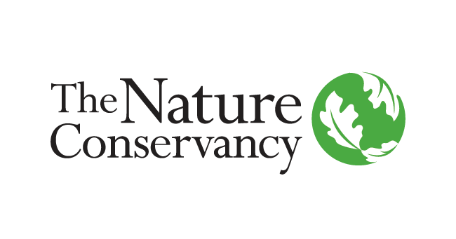
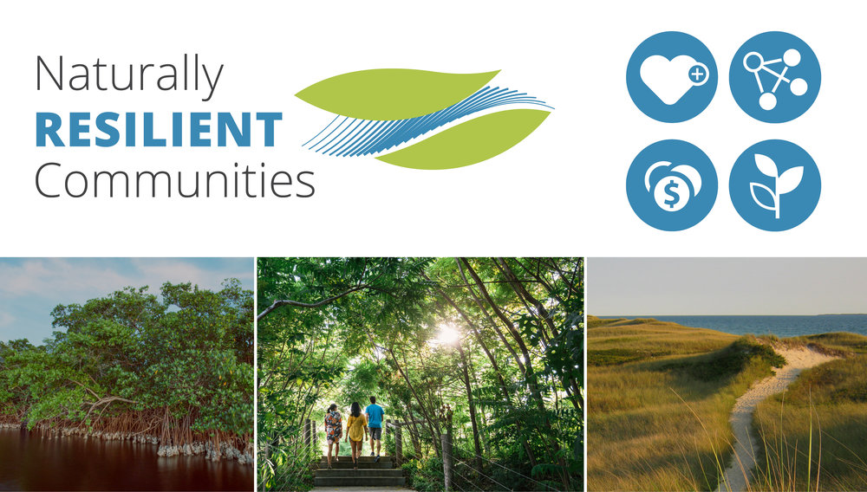
New Tools:
TNC’s Procurement Guide to Nature-Based Solutions
PART ONE – An Introduction to Nature-Based Solutions
  I. Why Communities Should Consider Nature-Based Solutions
  II. Planning for Nature-Based Solutions
    i. Alternative Solutions
    ii. Public Participation
PART TWO – Request for Proposal
  I. Background
  II. Project Goals/Summary
  III. Proposal Format and Content
  IV. Selection Criteria/Evaluation and Team
  V. Selection Process
  VI. Extras
  VII. Scope of Work
http://nrcsolutions.org/
Notes:
Another tool communities might find useful is TNC’s Procurement Guide to Nature-based solutions.
It’s a guidance document to help plan NBS and making sure the people you hire to design and implement your project do a good job.
It can be located at the Naturally Resilient Communities Page, which also hosts a ton of great case studies and links to resources

Slide 22
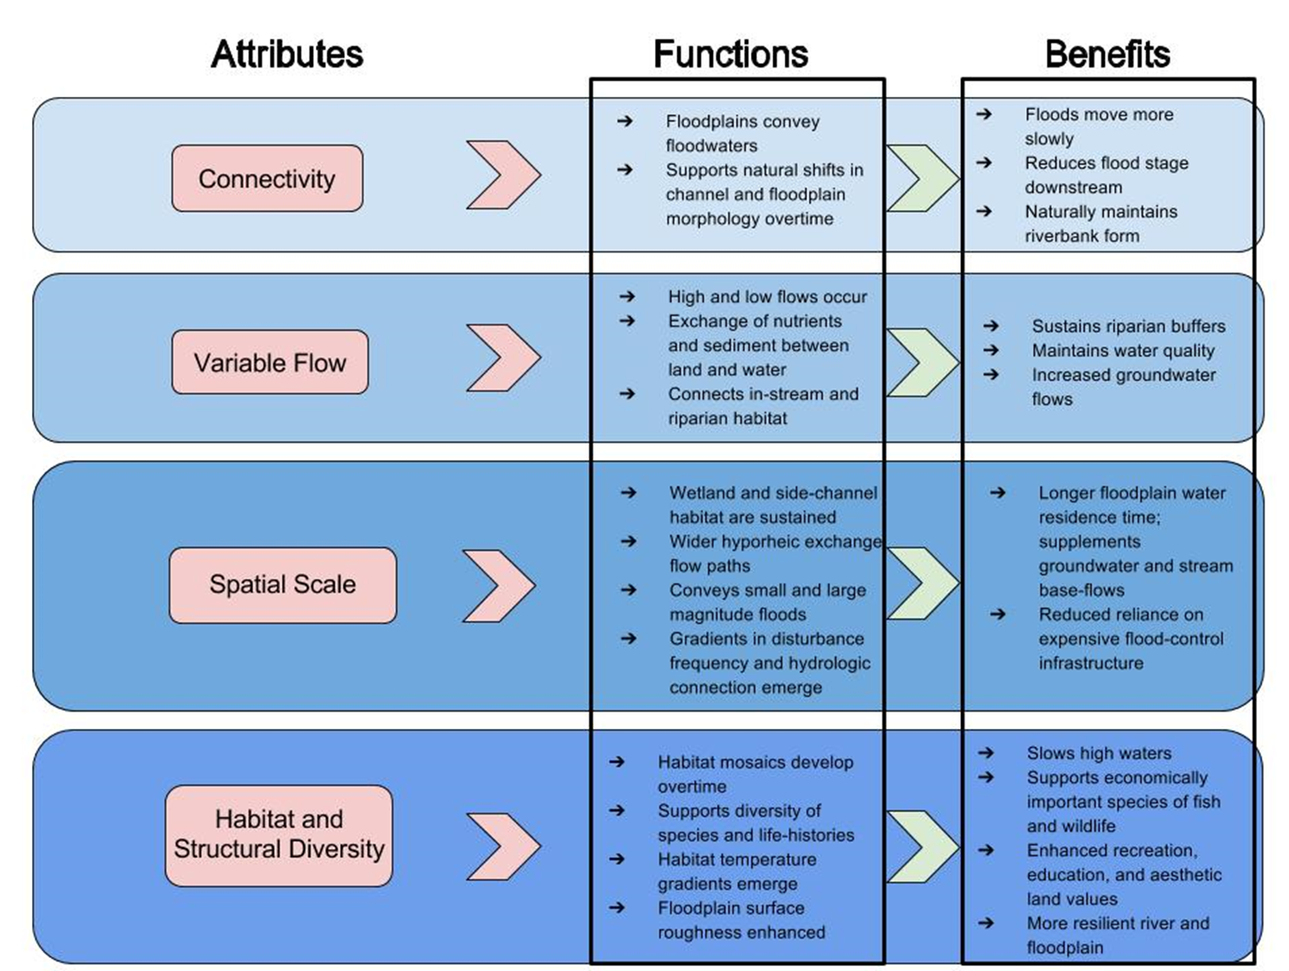
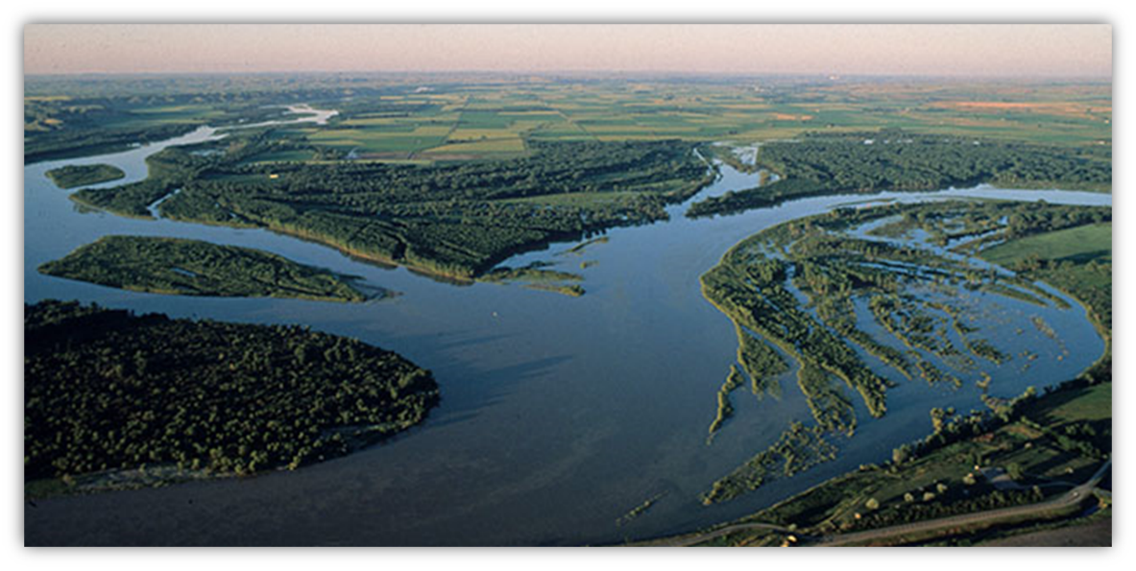
New Tools:
AR’s Reconnecting Rivers to Floodplains Report
https://www.americanrivers.org/conservation-resource/reconnecting-floodplains/
Notes:
And finally, shameless plug for AR’s report on Reconnecting Rivers to Floodplains.
I mentioned the four attributes of floodplains that we focus on restoring functional floodplains.
This report delves into the science behind those attributes

Slide 23
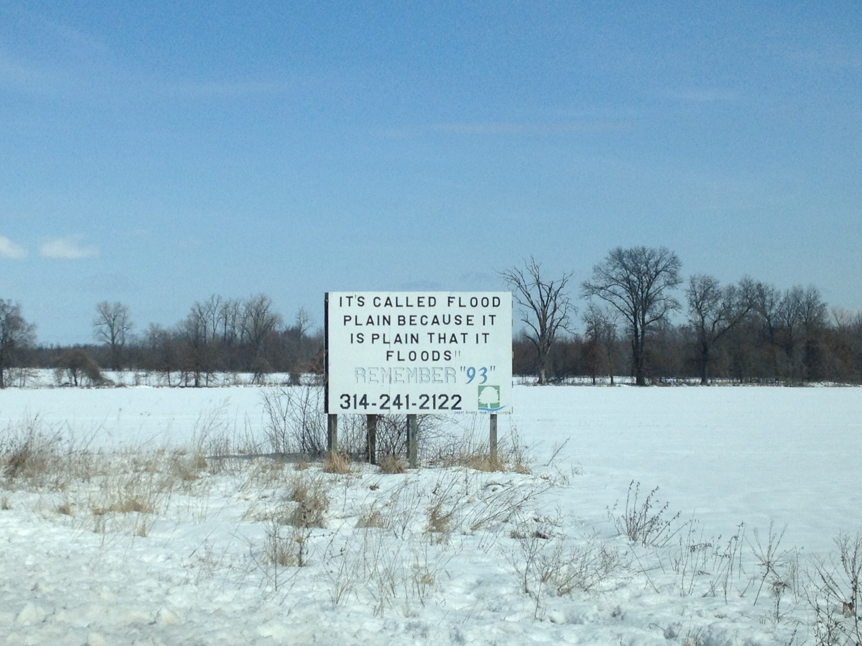

Resources:
Reconnecting Rivers to Floodplains, American Rivers:
www.americanrivers.org/conservation-resource/reconnecting-floodplains/
CRS Green Guide, ASFPM: www.floodsciencecenter.org
Naturally Resilient Communities and Procurement Guide : nrcsolutions.org
CA Central Valley multi-benefit projects: www.multibenefitproject.org
Floodplains By Design, WA: www.floodplainsbydesign.org
VT Rivers Program: dec.vermont.gov/watershed/rivers
Natural Floodplain Functions Alliance: www.aswm.org/watersheds/natural-floodplain-function-alliance
Natural and Beneficial Functions Committee, ASFPM: www.floods.org
Eileen Shader eshader@amrivers.org
www.americanrivers.org

